Slide 1
END USER COMPUTING.
BICT 1101
Lecture 5: Databases

Slide 2
INTRODUCTION TO DATABASE
Database is an organized collection of related data designed and built for a specific purpose, this data is stored in a computer system.
Databases allow their users to enter, access, and analyze their data quickly and easily.
Data organized in a database can be easily accessed, managed and updated.
Database can store information about people, products, orders or anything else.

Slide 3
CONTD…
To create and manage databases, we use Database Management System Software (DBMS).
DBMS manages incoming data (creation), organizes it (organization), and provides ways for the data to be modified or extracted by users or other programs (maintenance of databases).

Slide 4
CONTD…
Examples of Database Management software include
  Microsoft Access
  Microsoft SQL Server
  Oracle
  FoxPro
  Dbase IV
  Lotus Approach
  MySQL.
Microsoft Access is a database creation and management program/software we will use for this course.

Slide 5
CONTD…
MS Access is a Database Management program that stores information in tables that are related to each other.
  MS Access is a relational database.
In a relational database data is organized in related tables.
In related tables, one or more fields are linked to fields in another table.

Slide 6
CONTD…
This link ensures that you can enter only values that have corresponding entries in the other table.
Relational database relates, or connects data in different files by using key fields.

Slide 7
TABLES
When you use a database, you store your data in tables.
A table is a database object that you use to store data about a particular subject, such as employees or products.
A table consists of records and fields.
  A record is also called a row or an instance.
  A field is also called a column or an attribute.
A database can contain many tables, each storing information about a different subject.
Each table can contain many fields of different types of data, such as text, numbers, dates, currency etc.

Slide 8
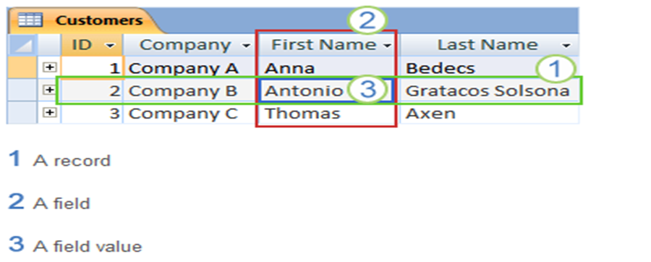
CONTD…
A table is a collection of related information that is organized in columns (fields) that describe an entity (record).
A Record is a collection of information about a specific entity, such as a student, applicant, program or project.
An entity is a person, place, thing or idea.
If we have pieces of information, on one subject, we have a record.

Slide 9
TABLE RELATIONSHIPS
To connect the data stored in different tables, you create relationships.
A relationship is a logical connection between two tables that specifies fields that the tables have in common.

Slide 10
TABLES (PRIMARY AND SECONDARY KEYS)
Keys
Keys are fields that are part of a table relationship.
A key may consists of one or more fields.
We will look at three kinds of keys: Primary, Foreign and Secondary Keys.
Primary key
A primary key is a field that uniquely identifies each record in a table.
A table can have only one primary key.
E.g. ID number, a serial number, or a code, that serves as a primary key

Slide 11
CONTD…
Foreign key
Foreign key is a field (or collection of fields) in one table that uniquely identifies a row of another table.
Foreign key is defined in a second table, but it refers to the primary key in the first table.
A foreign key contains values that correspond to values in primary key of another table.
A table can also have one or more foreign keys.
Relational database relates or connects data in different files by using key fields.

Slide 12
CONTD…
Secondary key
Secondary key is an additional key or alternate key, which can be used in addition to the primary key to locate specific data.
It is considered a candidate key for the primary key.
  It can uniquely identify a record.
Secondary key is not a foreign key

Slide 13
DATABASE DESIGN
Step 1: Identify the purpose of your database.
  This helps prepare you for the remaining steps.
Step 2: Find and organize the required information.
  Gather all types of information you might want to record in the database, such as product name and order number.
Step 3: Determine the tables you need.
  Divide your information items into major entities or subjects, such as Products or Orders. Each subject then becomes a table.

Slide 14
CONTD…
Step 4: Breakdown the tables into fields (columns).
  Decide what information you want to store in each table. Each item becomes a field, and is displayed as a column in the table. For example, an Employees table might include fields such as Last Name and Hire Date.
Step 5: Specify primary keys
  Choose each table’s primary key. The primary key is a column that is used to uniquely identify each row. An example might be Product ID or Order ID.

Slide 15
CONTD…
Step 6: Determine the relationships.
  Look at each table and decide how the data in one table is related to the data in other tables. Add fields to tables or create new tables to clarify the relationships, as necessary.
Step 7: Refine the design
  Analyze your design for errors. Create the tables and add a few records of sample data. See if you can get the results you want from your tables. Make adjustments to the design, as needed.

Slide 16
ADVANTAGES OF ACCESS
Minimizes duplicate data, increasing accuracy and consistency.
Data entry is faster and easier
Data can be viewed and sorted in many ways.
Information is more secure.
Data can be shared and edited by several users simultaneously.

Slide 17
ACCESS 2016 USER INTERFACE
Three main components of Access 2016 user interface are:
Ribbon - is the strip of tabs across the top of the program window that contains groups of commands.
Backstage view - is the collection of commands that you see on the File tab on the ribbon.
  Backstage view occupies the File tab on the ribbon and contains many commands.
  Backstage view also contains other commands that apply to an entire database file.
  In Backstage view, you can create a new database, open an existing database and perform many file and database maintenance tasks.

Slide 18
CONTD…
Navigation Pane
Navigation Pane - is the pane on the left side of the Access program window that lets you work with database objects.
Navigation Pane is organized by categories and groups.
You can minimize Navigation Pane, and you can also hide it.
When you open a database or create a new one, the names of your database objects appear in the Navigation Pane.
These three elements provide the environment in which you create and use databases.

Slide 19
DATABASE OBJECTS
Databases are composed of these objects: Tables, Queries, Forms, Reports, etc...,.
Together, these objects allow you to enter, store, analyze, and compile data however you want.
Tables
  A Table stores a collection of related information organized in columns (fields) and rows (records).

Slide 20
CONTD…
Queries
  A query is used to extract specific information from your table(s).
  It takes information from the selected tables and displays a subset of data that meets your criteria
Forms
  A form is a graphical representation used to enter or view data into a table.
Reports
  Presents data from a query or table and places it in neat, organized and readable form.

Slide 21
DATABASE CREATION
Create a database by using a template
Access provides a wide variety of templates that can be used to speed up database creation process.
A template is a complete ready-to-use database (predesigned) that contains professionally designed tables, queries, forms, and reports needed for performing a specific task.

Slide 22
CONTD…
Create a database by using a template
  Start Access 2016.
  On the New tab of Backstage view, click Sample Templates.
  Under Available Templates, click the template that you want to use.
  In the File Name box, type a file name.
  Optionally, click the folder icon next to the File Name box to browse to a location where you want to create the database.
    If you don't indicate a specific location, Access creates the database in the default location that is displayed below the File Name box.
  Click on the Create button.

Slide 23
CONTD…
A blank database
You can start a database from scratch if you want. This is a good option if you have very specific design requirements or have existing data that you need to accommodate or incorporate
Create a blank database
  Start Access 2016.
  On the New tab of Backstage view, click Blank Database. Or on the File tab, click New, and then click Blank Database.
  In the right pane, under Blank Database, type a file name in the File Name box.

Slide 24
CONTD…
  To change the location of the file from the default, click Browse for a location to put your database (next to the File Name box), browse to the new location, and then click OK.
  Click Create.
Access creates database with an empty table named Table1, and then opens Table1 in Datasheet view.
The cursor is placed in the first empty cell in the Click to Add column.
Begin typing to add data, or you can paste data from another source that has been copied from another source into an Access table.

Slide 25
MS ACCESS VIEWS
Two types of views that can be used in access are:
  Datasheet view and Design view
Datasheet view
  In Datasheet view, you can edit fields, add and delete data and search for data.
  Entering data in Datasheet view is designed to be similar to working in an Excel worksheet.
  Datasheet view is a spreadsheet-like view of the data in a table.

Slide 26
CONTD…
Design view
  Opening a table in Design view gives a detailed look at the table's structure.
  Design view provides the most options for defining fields.
    For example, you can find the data type setting for each field.

Slide 27
CREATING A TABLE
Three essential tasks in creating a table:
  Naming the table
  Naming the fields (columns)
  Selecting data types for each field (e.g. number, text, dates currency etc.)

Slide 28
ADD A TABLE
You can add new tables to an existing database by using Commands in Tables Group on the Create Tab and also from Templates in Application Parts.
Create a table, starting in Datasheet view
In Datasheet view, you can enter data immediately and let Access build the table structure behind the scenes.
Field names are assigned numerically (Field1, Field2, and so on),
Access automatically sets each field's data type, based on the data you enter.

Slide 29
CREATE A TABLE, STARTING IN DESIGN VIEW
In Design view, you first create the table structure.
Then switch to Datasheet view to enter data.
On the Create Tab, in the Tables Group, click Table Design.
For each field in your table, type a name in the Field Name column, and then select a data type from the Data Type list.
If you want, you can type a description for each field in the Description column.
The description is then displayed on the status bar when the cursor is located in that field in Datasheet view.

Slide 30
CONTD…
The description is also used as the status bar text for any controls in a form or report that you create by dragging the field from the Field List pane, and for any controls that are created for that field when you use the Form Wizard or Report Wizard.
After you have added all of your fields, save the table:
  On the File Tab, click Save.
You can begin typing data in the table at any time by switching to Datasheet view and clicking in the first empty cell.

Slide 31
DATA TYPES
Every field has a data type.
A field's data type indicates the kind of data that the field stores, such as text (large amounts of text or attached files), number, date/time, currency etc..
A data type is a field property, but it differs from other field properties as follows:
  You set a field's data type in the table design grid, not in the Field Properties pane.
A field's data type determines what other properties the field has.
You must set a field's data type when you create the field.

Slide 32
SET OR CHANGE PRIMARY KEY
Select the table whose primary key you want to set or change.
On the Home Tab, in the Views Group, click View, and then click Design View.
In the table design grid, select the field or fields that you want to use as the primary key.
  To select one field, click the row selector for the field you want.
    Row selector: A small box or bar that, when clicked, selects an entire row in table Design view, or when you sort and group records in report Design view.

Slide 33
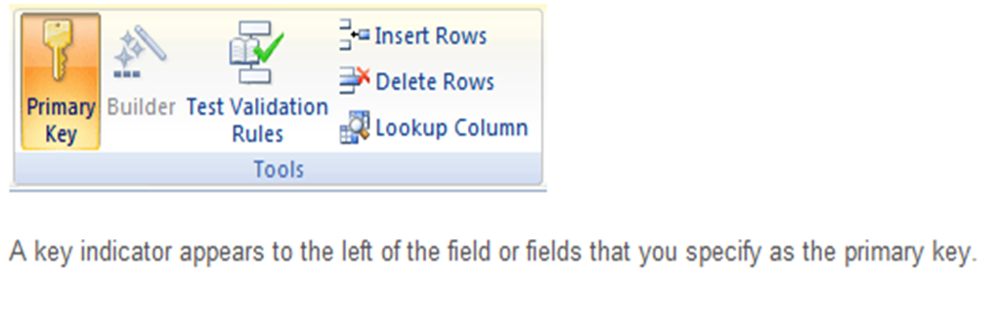
CONTD…
To select more than one field, hold down CTRL key, and then click the row selector for each field.
On the Design Tab, in the Tools Group, click Primary Key.

Slide 34
REMOVING PRIMARY KEY
Select the table whose primary key you want to remove.
On the Home Tab, in the Views Group, click View, and then click Design View.
Click the row selector for the current primary key.
  If the primary key consists of multiple fields, hold down CTRL Key, and then click the row selector for each field.
On the Design Tab, in the Tools Group, click Primary Key.

